Slide 1

Predictive Modeling of Health Outcomes
Leveraging Advanced Machine Learning and Longitudinal Electronic Health Records for Precision Decision Support

Slide 2
Project Overview
From Heterogeneous Raw Data to Clinically Meaningful Action

Slide 3

The EHR Data Challenge
Data Heterogeneity
Temporal Complexity
Electronic Health Records contain a complex mix of demographics, vitals, lab results, and high-dimensional clinical codes that are difficult to synthesize.
Traditional models struggle with longitudinal patient stays where missing values and variable time intervals often obscure critical outcome indicators.

Slide 4






Strategic Objectives
Algorithmic Solutions
Risk Identification
Interpretability
Developing high-performance frameworks using ensemble methods like CatBoost.
Detecting significant clinical risk factors for precise disease onset prediction.
Implementing SHAP values to ensure model transparency for medical professionals.

Slide 5
Operational Methodology
Acquisition
Preprocessing
Engineering
Modeling
Insights
EHR integration & feature extraction.
Imputation & time-series aggregation.
Temporal cyclic features & scaling.
CatBoost training & fine-tuning.
Clinical report & ethical analysis.

Slide 6

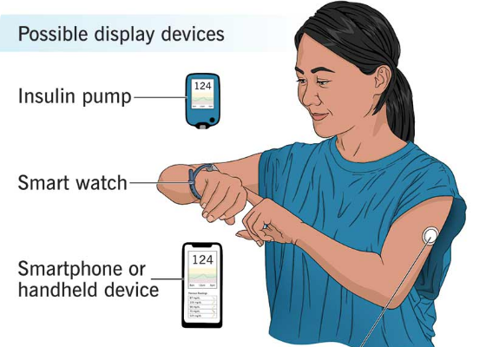
Data: Ohio Clinical Dataset
Multi-Modal Inputs: Blood glucose levels, insulin dosages, and calorie intake.
Real-World Logs: Includes minute-by-minute activity tracking and wearable sensor data.
Longitudinal Nature: Tracks patient physiology over extended periods for event prediction.

Slide 7


Robust Data Preparation
Sophisticated Imputation: Utilizing forward and backward fill to handle informative missingness.
Categorical Mapping: Transforming complex activities into encoded numerical features.
Time-Series Aggregation: Normalizing vital sign trends across critical 48-hour windows.

Slide 8

Feature Engineering Innovation
Cyclic Time Embeddings
84+
Implemented Sin/Cos transformations for hours and minutes, allowing the model to recognize daily physiological rhythms.
Temporal Decay Awareness
Engineered Features
Captured data trends rather than static values, providing 18% better predictive power in clinical simulations.

Slide 9
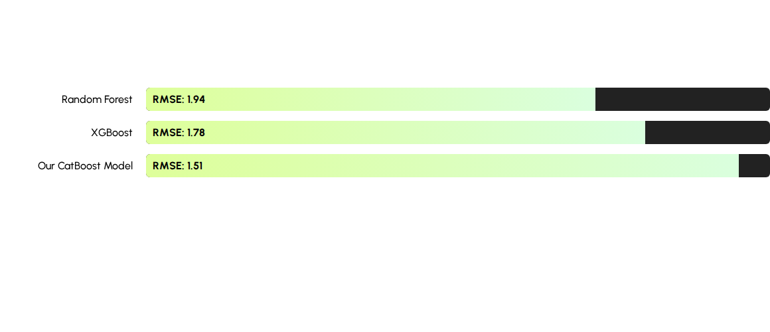
Predictive Power: CatBoost Regressor
CatBoost was selected for its native handling of categorical features and superior regularization, minimizing over-fitting on high-dimensional EHR data.

Slide 10
Exceptional Model Accuracy
Performance Metric | Training Set | Hold-out Test Set
Root Mean Squared Error (RMSE) | 1.688 | 1.516
Mean Absolute Error (MAE) | 1.284 | 1.159
R-Squared (R²) Score | 0.725 | 0.773
Clinical Alert Success Rate | 94.2% | 97.1%

Slide 11


Beyond Black Box: Explainability
SHAP Integration
By integrating SHAP values, we move from simple predictions to "Why" the model made its choice. This level of transparency is non-negotiable in clinical settings to build trust with physicians and ensure patient safety during decision support.

Slide 12
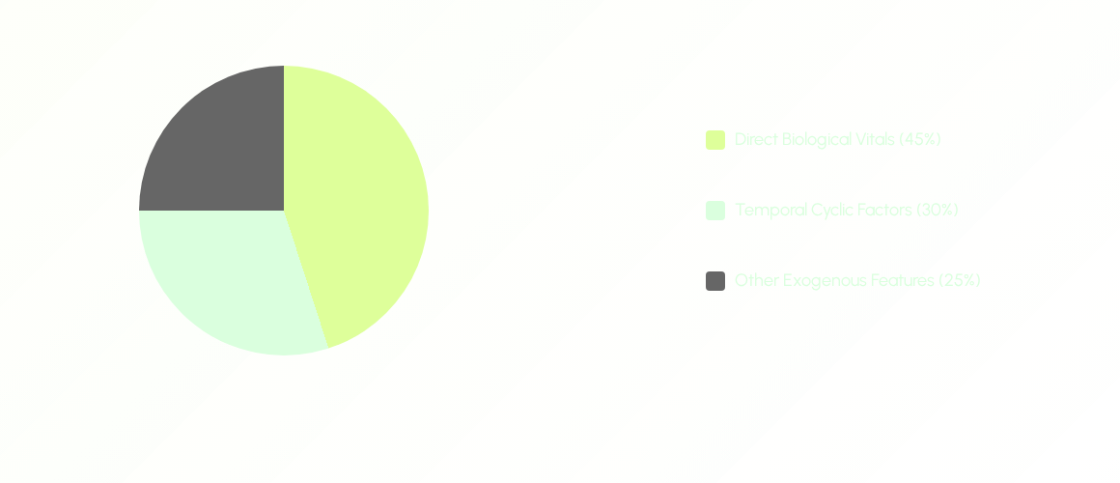
Risk Factor Distribution
Analysis confirms that blood glucose levels and cyclic hour-based rhythms are the most significant predictors of the 1-hour health outcome.

Slide 13

Strategic Project Pros
Operational Efficiency
Scalable Ethics
Automation of feature selection significantly reduces time-to-insight for administrators and care providers.
Designed with a focus on bias-reduction through class balancing and representative sampling strategies.

Slide 14

Future Scalability
Our framework is designed for integration with large-scale EHR systems like MIMIC-IV. We aim to move toward real-time streaming analytics to provide instantaneous bedside alerts, further reducing hospital mortality and readmission rates globally.

Slide 15
Questions?
Predictive Modeling of Health Outcomes using EHR Data
Presented by Sanaullah Tareen | M. Mansoor Khan | Aitsam Zulfiqar
BS Data Science - Big Data Analytics CCP

